Slide 1

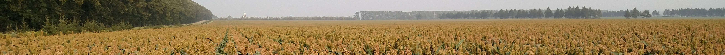


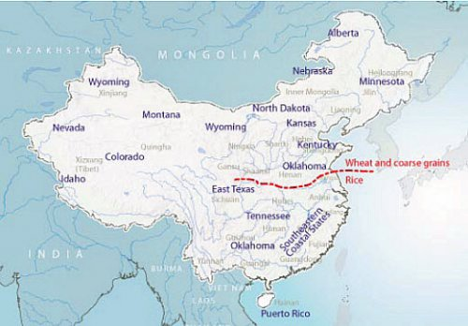
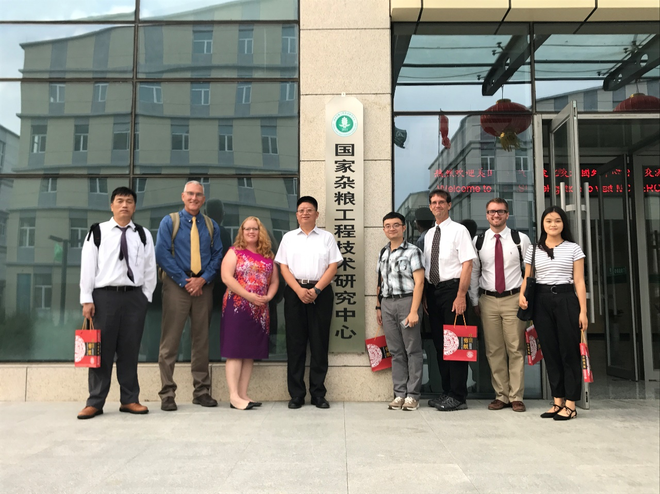
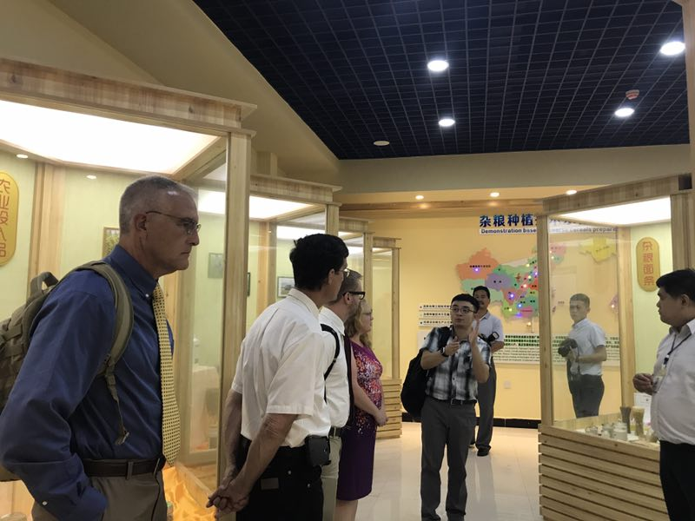
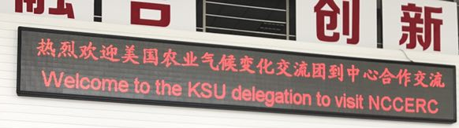


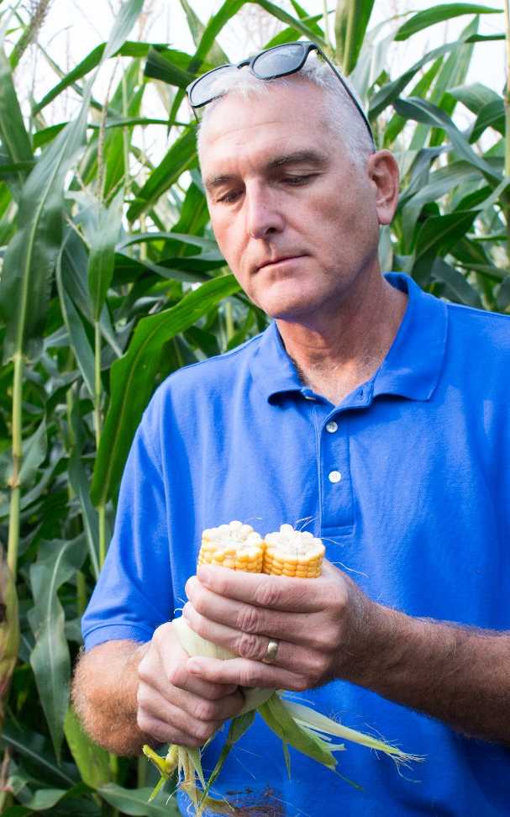
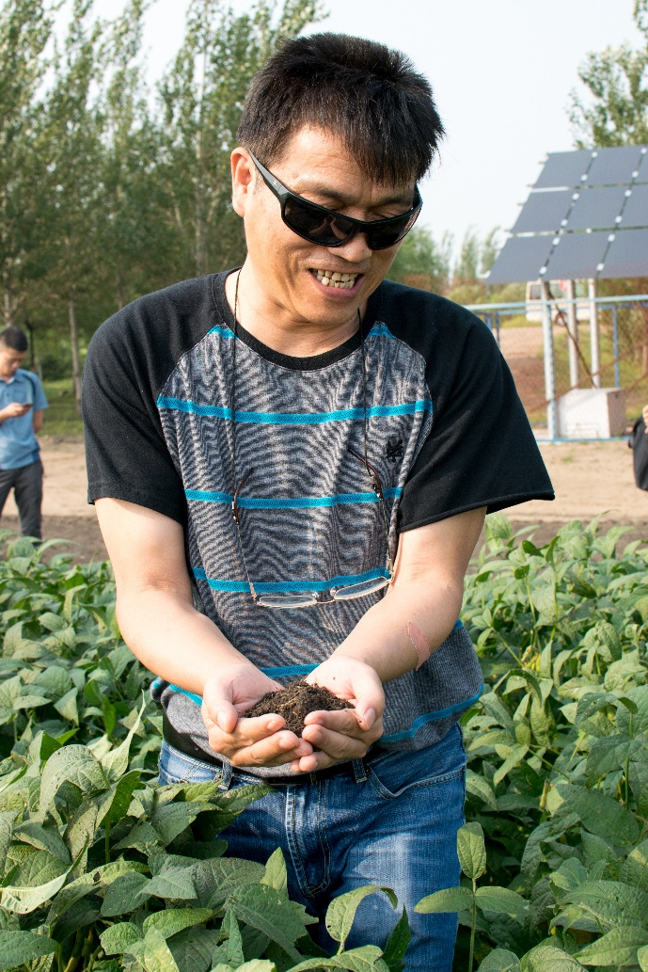
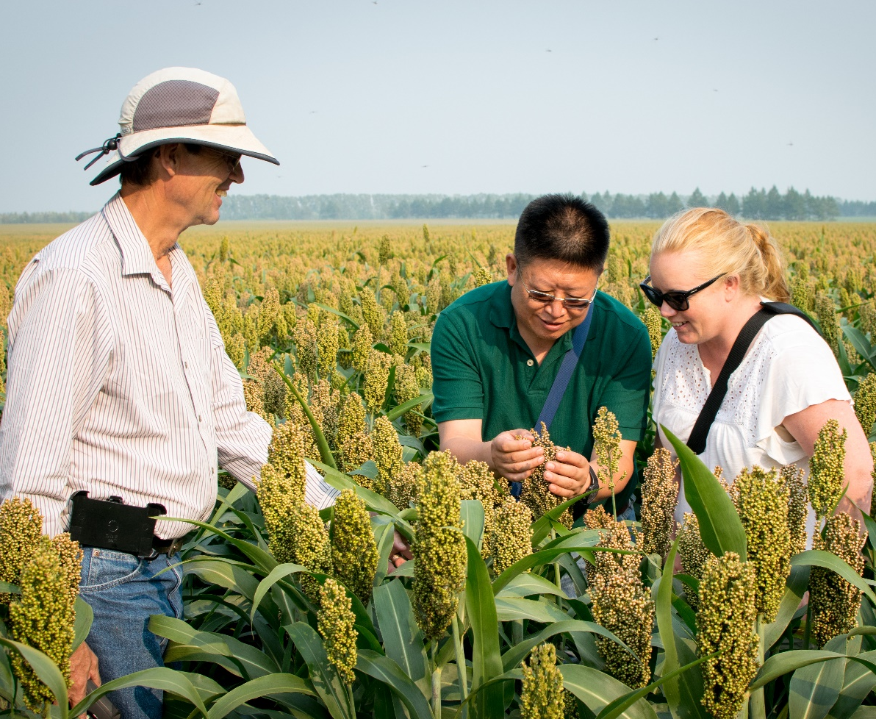
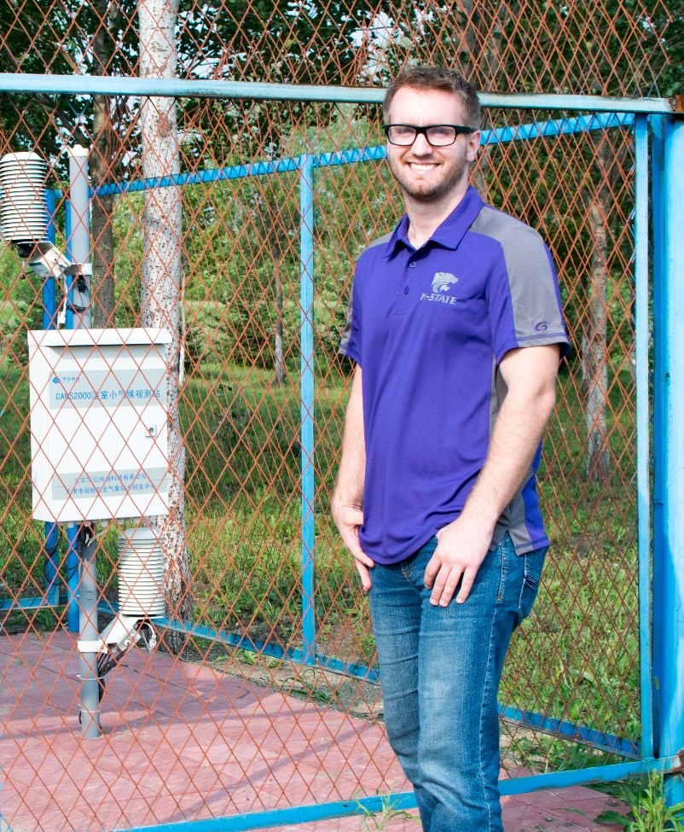
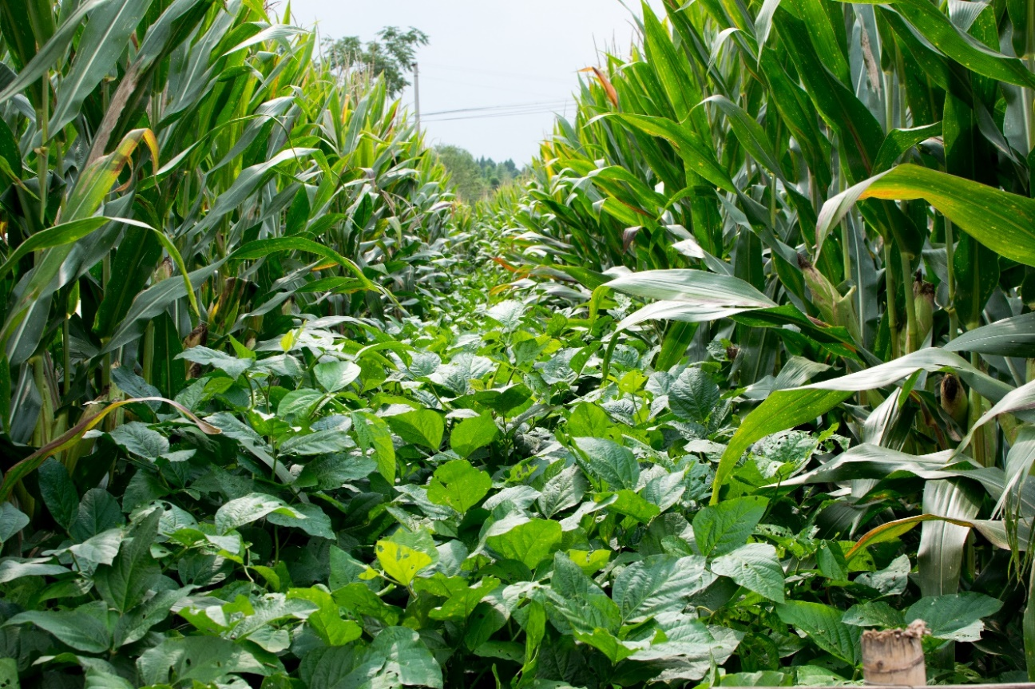


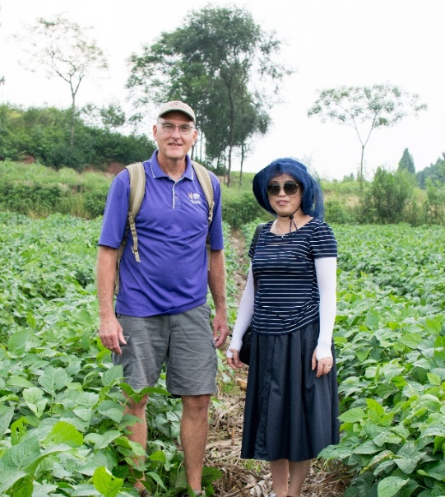
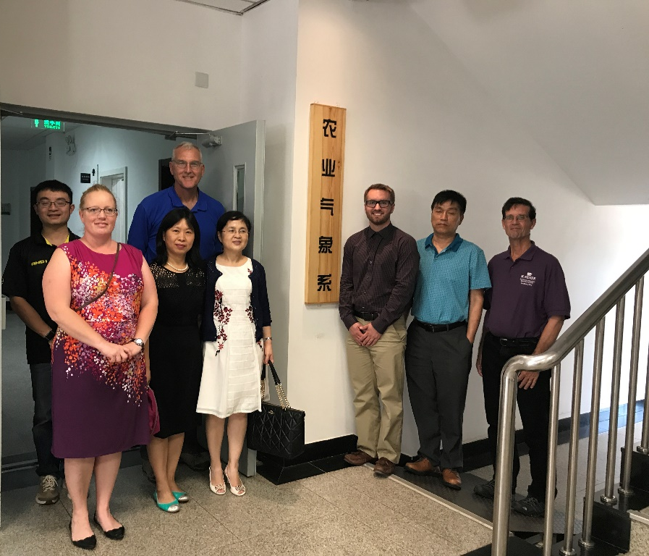
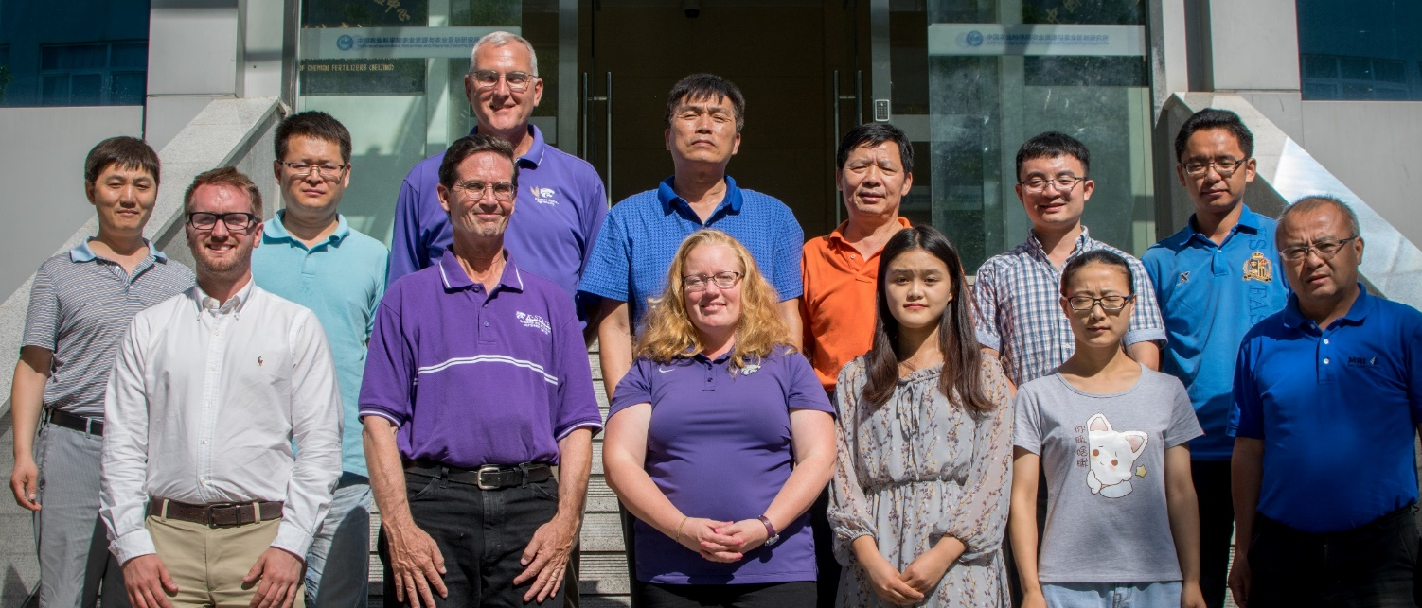
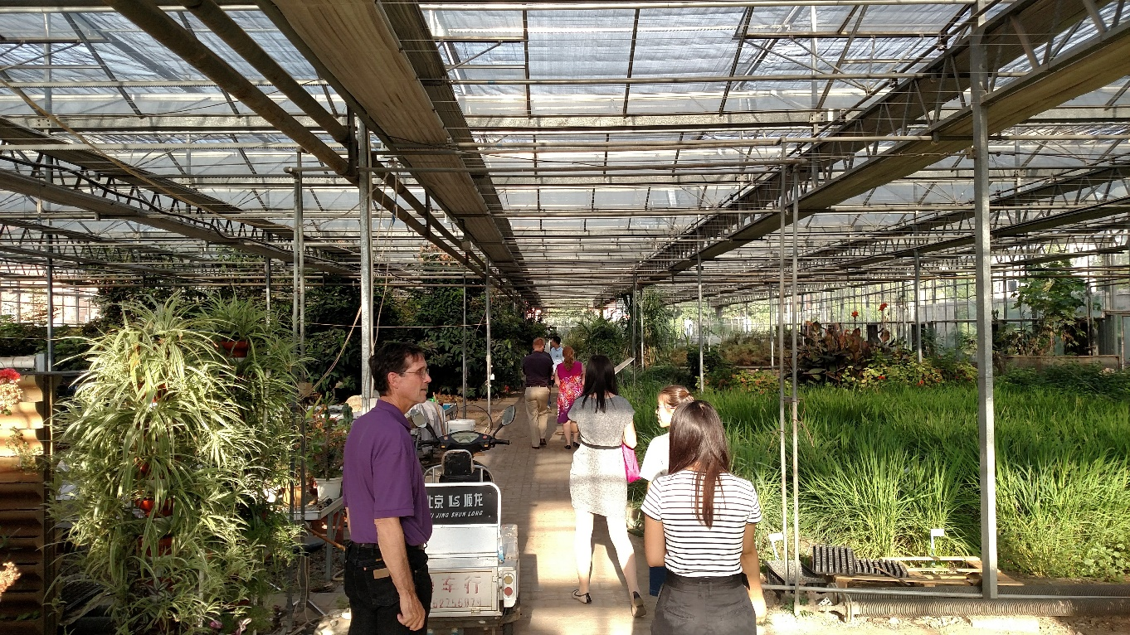
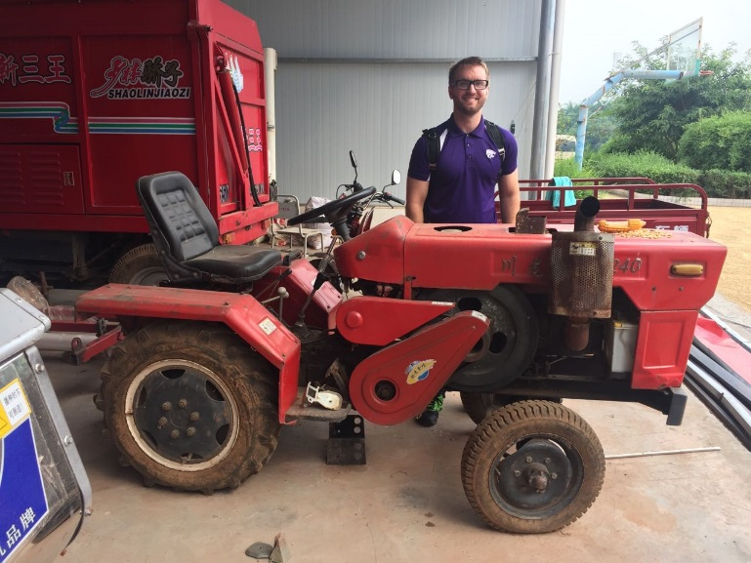
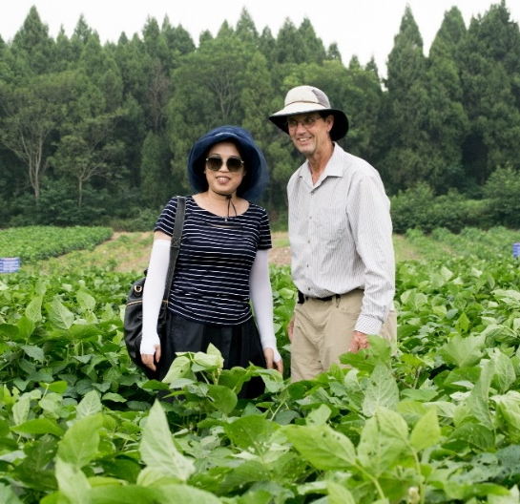
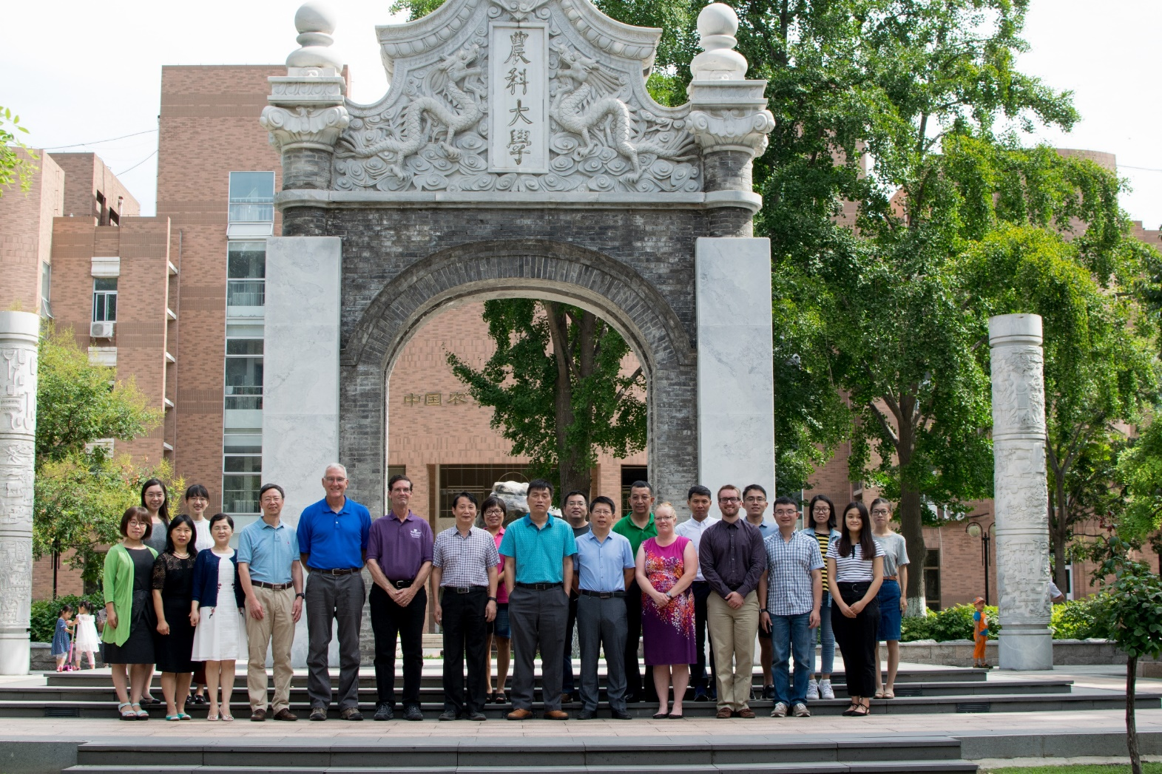
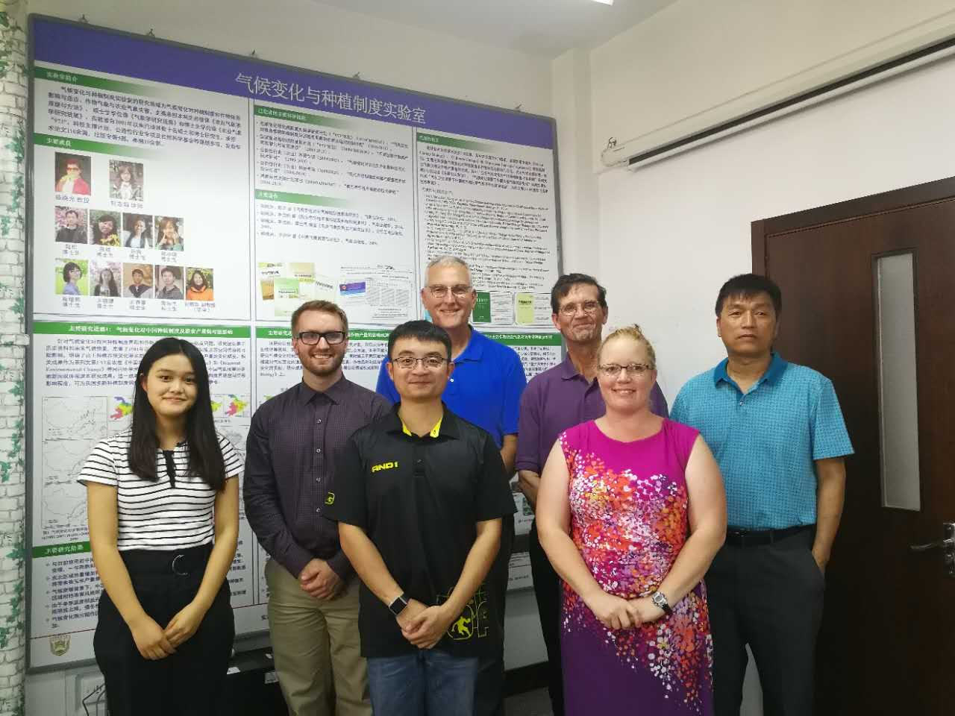
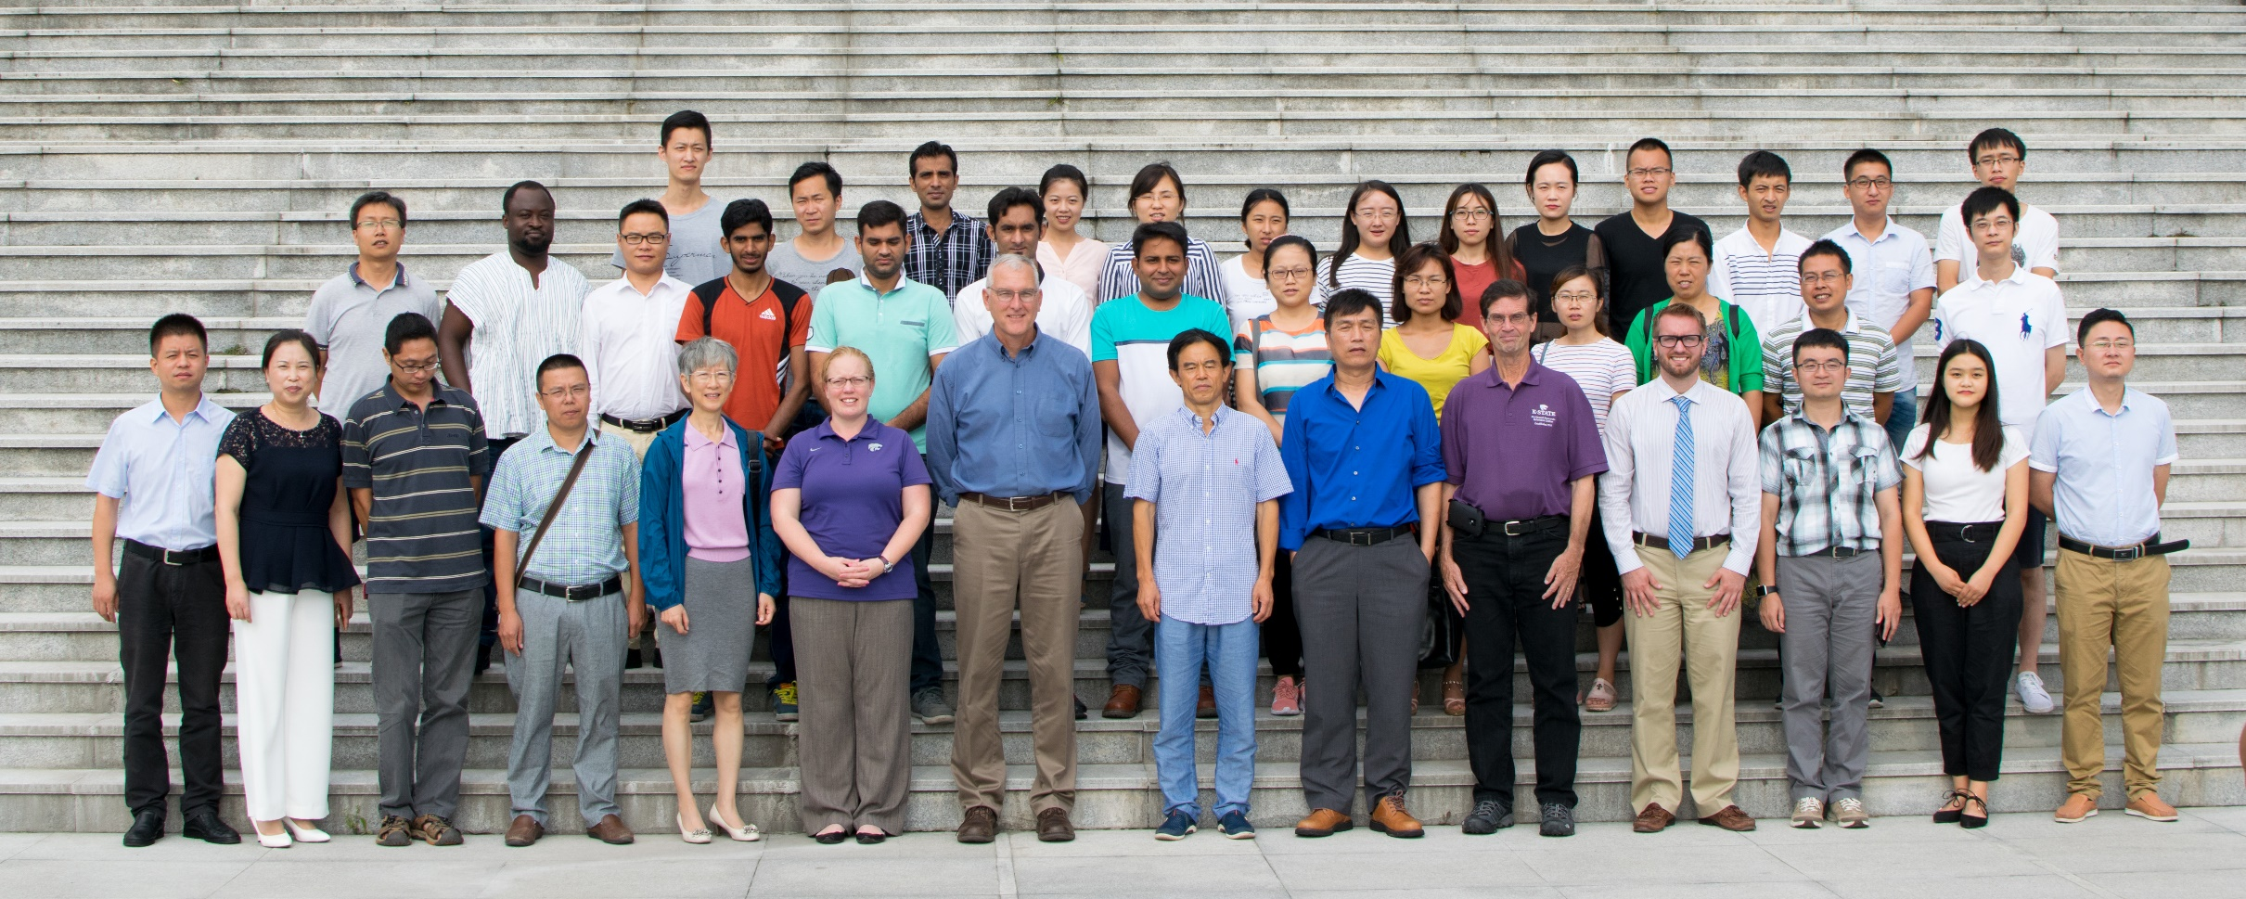
2017 U.S China USDA
Scientific Cooperation
Exchange Program (SCEP)
Adjusting Agricultural Practices in Response to Environmental Change - Climate Resilient Agriculture
Background
Daqing, Heilongjiang
Exchange knowledge on the impacts of environmental changes on crop production and practices and climate-informed tools that are being developed to increase cropping system resilience with a specific focus on corn, soybean, and wheat production systems.
Explore collaborative priorities and mechanism for ongoing U.S.-China cooperation on challenges to production of these crops presented by environmental changes and the development of ag-climate risk monitoring tools through integrating soil health, water and nutrient management, crop modeling, and climate information.
KSU Team
Our presentation included:
Overview of major Innovation Labs hosted by the K-State College of Agriculture.
Recent evidence of climate change and impacts in the U.S. Great Plains.
Effects of water limitations on productivity of wheat and new approaches to identify varieties with enhanced water productivity.
Tillage impacts on soil erodibility and benefits of cover crops for soil protection, nutrient management, and improving cropping system resilience.
China and the US share similar climate regions and have large fertile land areas rich in natural resources in common, and a need to sustain agricultural productivity under a changing global climate.
The scientific focus for this exchange was to help strengthen climate change adaptation practices and technologies in cropping systems to
- minimize (maximize) the negative (positive) impacts of climate change.
This exchange will strengthen and build on past and existing collaborations between Chinese scientists and Kansas State University.
Knowledge gains in climate science and cropping systems can reduce uncertainty in dynamic weather conditions that confront US farmers.
Itinerary
  Meeting at National Coarse Cereals Engineering Research Center at Bayi Agricultural University (BYAU)
  National farm visit
Outcomes and accomplishments
Awareness of large-scale Chinese cropping and land management systems.
Barriers and opportunities associated with cropping and management systems (small holders, collectives, and federal farms).
Identified on-going opportunities for student and faculty exchanges between KSU and BYAU.
    Benefits to US agriculture
    Increased productivity of grain sorghum under cool growing conditions.
Figure 1. Climate of China, comparing it to equivalent agricultural areas in the U.S. (adapted from E.B. Garriss, 2012, the World Climate Bulletin).
Daqing, Heilongjiang
Front row: Melanie, Kraig Roozeboom, Robert Aiken, Xiaomao Lin, Deann Presley, Back row: Yuxin He* (Sichuan U.), Zach Zambreski
Objectives
Chengdu, Sichuan
Figure 9: KSU SCEP team and Dr. Zheng after discussions at the Coarse Grain Center.
Figure 10: KSU SCEP team receiving a tour of the Coarse Grain Center on Bayi Agricultural University campus.
Itinerary
  Meeting at Sichuan Agricultural University (SCAU)
  Renshou field visit
Outcomes and accomplishments
  The faculty of SCAU have developed advances in inter-cropping production methods and knowledge related to increased productivity and sustainability.
  Improved light use efficiency created by optimizing distances between wide and narrow strips increases soybean yield production.
  Challenges to adoption in mechanized agriculture include machinery design, pest management, and development of adapted cultivars.
  Joint-research collaboration opportunities in inter-cropping and rotation cropping systems (maize and soybean).
  Student and faculty short-term exchanges.
    Benefits to US agriculture
  Potential increase in productivity per acre in water-sufficient regions from intercropping system.
Figure 2: Intercropping system of maize and soybean.
Figure 11: Highlights from the national farm tour in northern Heilongjiang. Intensive management of maize, soybean, and sorghum cropping systems in a climate sensitive environment leads to high-yield production.
Beijing
Itinerary
  Meeting at the Chinese Academy of Agricultural Sciences (CAAS)
  Meeting at China Agricultural University (CAU)
Outcomes and accomplishments
  Near-term collaboration with the CAU agro-meteorology program on:
    Algorithms for drought indices
    Wheat yield modeling
    Analysis of US cropping systems in response to climate change
    Yield gaps in US and China and their limiting factors
    Differences in wheat productivity
    Student and faculty short-term visits.
    Undergraduate and graduate training programs between KSU and CAU.
    Joint-research in climate adapted crop cultivars and cropping practices.
    Benefits to US agriculture
    Better understanding of potential cropping system shifts resulting from climate change.
    Develop new sources of cold tolerance in grain sorghum.
Figure 5: KSU SCEP team and faculty at the Chinese Academy of Agricultural Sciences.
Figure 7: Tour of CAU greenhouse experiments (left) and the KSU SCEP team at the CAU Department of Agricultural Meteorology (right).
Figure 3: Highlights from the SCAU Renshou field site visit including soils, cropping systems, and technology used for their intercropping systems.
Figure 4: KSU SCEP team and Sichuan Agricultural University faculty and graduate students.
Figure 6: KSU SCEP team and administration, faculty, and graduate students at China Agricultural University.
Figure 8: KSU SCEP team in the graduate student labs at the CAU agricultural meteorology department.

